Slide 1
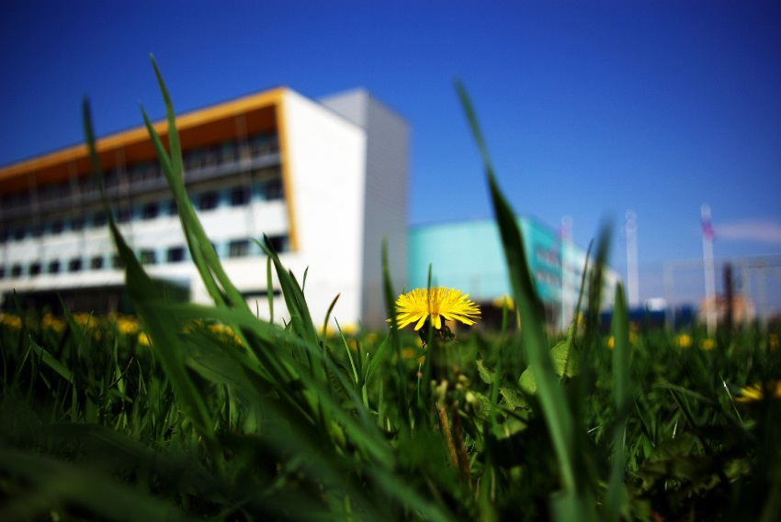
Astangu Vocational Rehabilitation Centre
Together we can create a better life every day, with every thought and action

Slide 2
What do we do?
Offer different study and labor market participation options to people with various special needs and health issues based on their personal needs
Support people with different rehabilitation services
Develop the field of rehabilitation and share our competence with other service providers

Slide 3
Some facts about us
Created in 1996
Created and administered by the Ministry of Social Affairs
2001 – membership in the European Platform for Rehabilitation (EPR)
2011, 2013 & 2016 – received EQUASS Assurance quality certificate
Over 1000 graduates
Currently about 126 students and 118 employees

Slide 4
Who do we work together with?
Working-age people (16-64 years) with special needs
People and organizations interested in developing social and educational fields in Estonia and abroad

Slide 5
What kind of special needs?
learning difficulties
intellectual disabilities from mild to moderate
congenital and/or chronic health impairments
hearing loss or deaf people
acquired physical disabilities and traumatic brain injury
mental health conditions, including people with autism
We aim to base our services according to individual needs

Slide 6
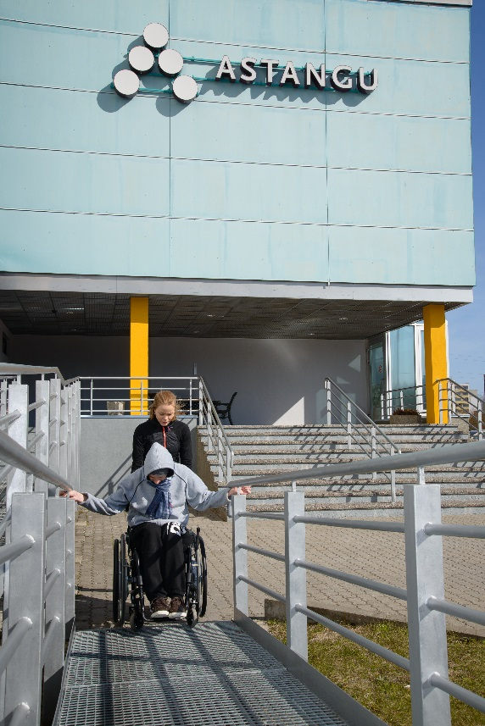
What do we offer?
Assessment & counselling
Study opportunities
3 sheltered workshops
Rehabilitation services
Supported employment service
Consultations regarding environment adaptation
600 people used the services of Astangu in year 2016.

Slide 7
Assessment & counselling
Assessing people’s abilities and needs
Available to all working-age people interested in finding out more about available self-actualization opportunities
Counselling and recommendations for further activity

Slide 8
Studying opportunities
Prevocational courses (currently 40 students)
Adaptation year, various concentrations
Course „Introduction to Information Technology“
Post-traumatic brain injury rehabilitation programme „I want to work“

Slide 9
Studying opportunities
Vocational training courses (currently 22 students)
Cleaning and home maintenance
Baking
NEW! Helpdesk worker IT-course
Vocational education (currently 58 students)
Cook’s assistant, carpenter, (software developer, office worker)

Slide 10
Sheltered workshop opportunities
Carpentry
Handicrafts
Simple tasks

Slide 11
Rehabilitation
Individual assessment of rehabilitation needs
We provide Work/Vocational rehabilitation and Social rehabilitation Service.

Slide 12
Employment Unit
Created in 2002
4 job coaches

Slide 13
Employment support
Supporting students in finding traineeship and job opportunities
Supporting sheltered workshop participants in finding a job and staying in open labour market
Supporting graduates in finding and keeping a job
Cooperating with employers

Slide 14
Main activities:
Preparing students for working life and supporting in the search for traineeship opportunities
Supporting students in finding job opportunities
Supporting graduates in finding and keeping a job;
Cooperating with employers
Estonian Unemployment Insurance Fund services, projects, employment statistics, and group work

Slide 15
Working with students
Career development classes
Company visits
Individual counselling
Organizing traineeships
Hamet
Jobpics

Slide 16
Working with graduates
Support in finding a job
Support in adapting to the job (gaining work skills, adapting with the work environment, communicating with the employer, etc.)
Continued support
Counselling for employers

Slide 17
Working with employers
One-on-one cooperation and training
Employers’ training days
Support during traineeship and client’s employment

Slide 18
Graduates activity (2016), 76 graduated

Slide 19
The whole picture
Assessment
Individual plan –
QoL based approach
Skills
development
Preparation for
working life
Studies / working in a
sheltered workshop
Supportive
rehabilitation
Job search
support
Leisure time
activities
Post-employment
counselling
Transition to working life

Slide 20
Other facts from 2016
37 people worked in sheltered workshops
5 proceeded to open labour market
104 people received rehabilitation services
201 people received counselling about environmental adaptation and AT
80% people are content with the services
39% of the students work in open labour market
84% of students are active after graduation

Slide 21
Statistics about people with disabilities in Estonia
Year | Children (0-17) | Working age people (18-64) | Elderly people (65+) | Total
2010 | 6408 | 45 734 | 66 225 | 120 432
2012 | 9 374 | 54 630 | 69 843 | 133 847
2014 | 10 673 | 57 444 | 72 909 | 141 026
2016 | 11 164 | 60 611 | 74 668 | 146 443
(11,1% of Estonian population had a disability 2016)

Slide 22
Estonian Unemployment Insurance Fund
Services for People with disabilities:
assistance at job interviews
adjustment of workspaces and working equipment
75%-100% costs compensated
also when working at home
free use of technical aids
up to 3 years, can be extended

Slide 23
Estonian Unemployment Insurance Fund
working with a support person
for persons who need more extensive guidance at work than usual
maximum 1000 hours during the first year
prolonged if needed but limited to 25% of working time
fee is 2.56 eur per hour
sheltered employment
Getting ready for working in the open labour market
sheltered employment: working at own pace and with extensive guidance
I stage (up to 4 months): assessment and trial
II stage (up to 8 months): working in sheltered conditions with employment contract and minimum wage guarantee, looking for job in the open labour market
III stage (up to 12 months): working at the normal work place, the support of the service provider is gradually reduced

Slide 24
Estonian Unemployment Insurance Fund
peer counseling
The person with similar disability or health problem shares his experience and gives guidance
Trainings for new consultants
work rehabilitation
for people who experience multiple obstacles due to their disability or health problem

Slide 25
Estonian Unemployment Insurance Fund
provision of advice and training for employers
compensation of labour market training for employers

Slide 26
State compensation
social tax compensation for a person with decreased working ability
holiday compensation
People with disabilities have a right for 35 calendar days of holidays instead of the usual 28 calendar days. State will pay 7 days instead of employer.
tax-free allowance for an employer to support a disabled worker using car between home and work
Notes:
470 eurot

Slide 27
State compensation
if the employee has incapacity for work or is assigned a degree of disability, the employer may provide the employee with non-tax-exempt aids
the medical expenses incurred by the employee as a result of an accident at work or an occupational disease are tax-free for the employer

Slide 28
Mental Health Center
Mental Health Center is usually a city social welfare institution that provides and develops mental health services for adults with psychiatric special needs.
Tallinn
Tartu

Slide 29
Mental Health Center
rehabilitation team
community care team
support home
clubhouse
therapy center
activity center

Slide 30
Thank you!
Astangu Vocational
Rehabilitation Centre

