Slide 1
Comparison of approaches in the hotel industry: traditional versus modern
LINDA BALOBINA&JĀNIS FORSTS
IVETA KĀPOSTA, assistant professor, Dr. paed.,
SIVA College

Slide 2

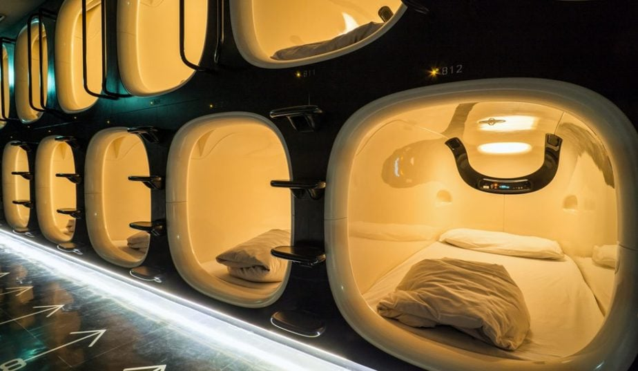
traditional versus modern
classic
Modern

Slide 3


- Digital integration.
Modern approach
- Data-driven strategies.
- Sustainability focus.
- Social media marketing.
- Improved convenience.
- Wider audience reach.
- Cost efficiency
Traditional approach
- Personalized service.
- Loyalty programs.
- Standardized operations.
Direct booking
- Personalized attitude
- Experience

Slide 4
Comparison of traditional and modern approaches
Aspect | Traditional Approach | Modern Approach
Service Style | Personalized, face-to-face | Automated, tech-driven
Marketing Strategy | Direct booking, physical presence | Digital marketing and social media
Customer Interaction | High-touch, personal relationships | Digital interfaces, AI interaction
Adaptability | Slow to adapt to new trends | Quickly adapts to market changes
Cost Structure | Higher staffing and training costs | Potential for reduced operational costs

Slide 5

by combining traditions with innovations, both, customers and hotel industry will benefit.

Slide 6
Thank you!

